Slide 1
Using Laboratory Equipment
Chapter 3

Slide 2
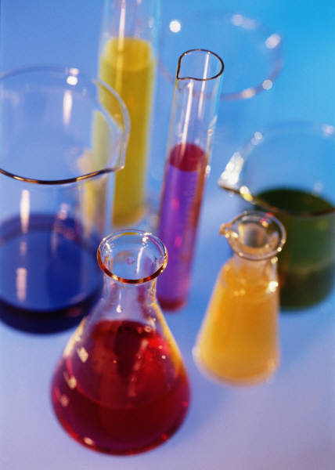
Laboratory Equipment
Containers and Holding Devices
Thermometers
Balances

Slide 3
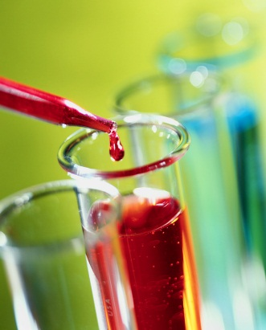
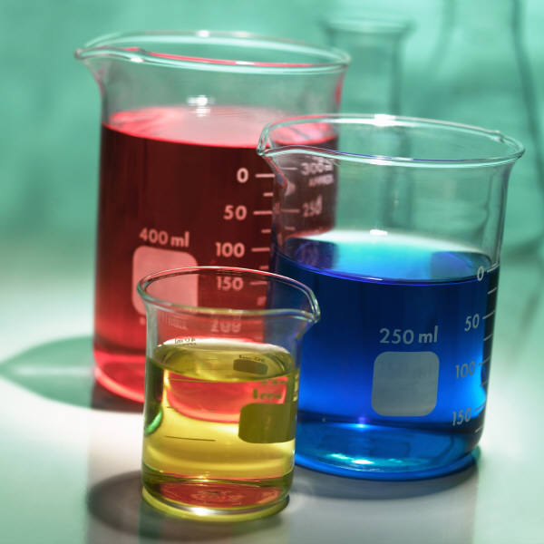
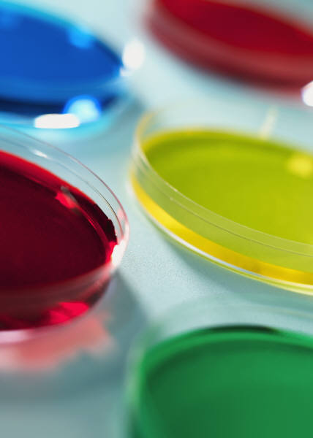
Containers and Holding Devices
Beakers
Graduated cylinders
Test tubes
Erlenmeyer flask
Burets
Petri dishes
Holding devices

Slide 4
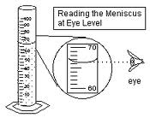
Meniscus
The bottom of the curve a liquid forms in a container.

Slide 5
Thermometers
Laboratory thermometers use the Celsius scale

Slide 6
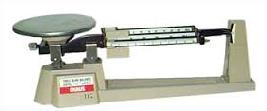
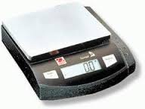
Balances-scientific instrument that determines the mass of materials
Triple-Beam Balances
Electric Balances
Caring for the Balance
  Respect the balance, it is delicate expensive instrument
Calibrating Measuring Equipment
  Check, adjust, or standardize the marks on a measuring instrument

Slide 7
Measurement
Chapter 4

Slide 8
Accuracy and Precision
Accuracy
  How close a single measurement comes to the actual or true value of the quantity measured.
Precision
  How close several measurements are to the same value.

Slide 9
The Metric System
Numbers are expressed in units of ten.
Prefix | Meaning | Numerical Value | Unit Example | Relationship to Unit
Kilo (k) | Thousand | 1000 | Kilometer (km) | 1km=1000m
Deci (d) | Tenth | 0.1 | Decimeter(dm) | 10 dm=1m
Centi (c) | Hundredth | 0.01 | Centimeter (cm) | 100 cm=1m
Milli (m) | Thousandth | 0.001 | Millimeter (mm) | 1000 mm = 1m

Slide 10
Recording Metric Data
Estimating
  Make it a habit to estimate to one decimal plae past the unit of measure marked on the scale
  Recording Final Zeros
    If the bottom of the meniscus is exactly on the 24-mL line you simply write 24mL in your data table.
    This suggests that the volume is closer to 24mL than to either 23mL or 25mL.
    If you record the data as 24.0mL, you make it clear that the volume is exactly 24 mL.
    By recording the final zero, you report your data more precisely.

Slide 11
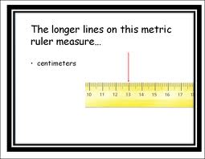
Measuring Length
Use metric ruler or meter stick
Millimeters are generally the smallest divisions represented

Slide 12
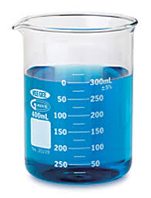
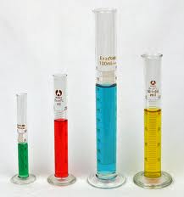
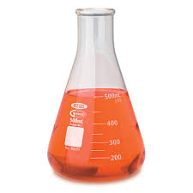
Measuring Volume
Several different containers can measure volume.
Refer to laboratory instructions for which container to use.

Slide 13
Measuring Mass
Use a balance to measure mass.

Slide 14
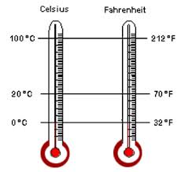
The Celsius Temperature Scale
When measuring the temperature of a substance, be sure the thermometer bulb is completely immersed in the container but not touching the sides or bottom.

